Slide 1


Bachelor Contestants Data Analysis
By Maggie Goodman
ENTITY Academy Data Science Final Project

Slide 2

Teacher of 10 years
Masters Degree in Childhood Special Education from Queens College (2017)
Bachelors Degree in Elementary Education/Human Development from Boston College (2012)
Began watching The Bachelor every Monday night with my mom and sister when I was 12 (2002)
General passion for reality television & entertainment
Currently employed with the New York City Department of Education as a Middle School Special Education Teacher
My
Background

Slide 3

The Bachelor, a reality television show created by Mike Fleiss, first aired in 2002 on ABC
26 seasons; 27th coming in January 2023
Premise
1 Bachelor
About 20-30 women (contestants)
Approximately 8 weeks
One-on-one and group dates each week
Weekly eliminations
Expectation of a proposal to one woman at the end
Project Introduction

Slide 4
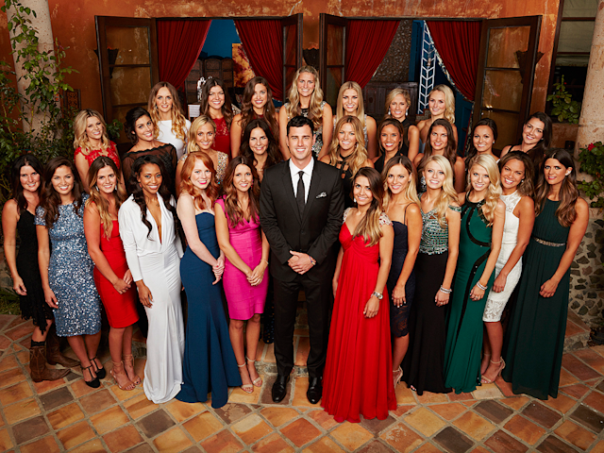
The Bachelor’s success led to many spin-offs, including The Bachelorette
Considering its longevity, the most data has been collected on The Bachelor
Popularly discussed contestant trends in recent years:
Fewer women over the age of 28
Slight increases in more ethnic diversity, but remain predominantly Caucasian
Few women of any faiths other than Christianity
Project Introduction (continued)

Slide 5
Gathering/Finding the Data
Dataset found on website called “Data World”
Manipulating/Wrangling the Data
Cleaned up the data as it came somewhat “messy” (inconsistent spelling, hyphens, etc.)
Added a variable of ‘hometown region’ based on ‘hometown’
Subset of the data created for Winners/Runner-Ups to better analyze trends in success on the show
Methods

Slide 6
Although there have been 26 seasons, the best data found was for Seasons 1-23 (with gaps for Seasons 3-4 and 6-9)
Data focused on the women (who will be referred to as “contestants” moving forward), specifically highlighting variables related to age, elimination week, & hometown
479 contestants in sample
Methods
(continued)

Slide 7
Evaluation Question #1:
How has the average age of a Bachelor Contestant changed over time (from 2002-2019, given the dataset)?
Hypothesis: The average age of a Bachelor Contestant has declined over time.
Evaluation Question #2:
Is a Bachelor contestant’s hometown region a predictor for success on the show?
Hypothesis: Hometown region is a predictor for success on the show.
Evaluation
Questions

Slide 8
Evaluation Question #1
Hypothesis: The average age of a Bachelor Contestant has declined over time. FALSE
While it is true that the average age of the standard Bachelor contestant is infrequently above 28, if ever, it is false that average age has declined over time.
On the next slide, it is clear that, while average age has fluctuated a bit over the years, it really has not changed too much in 23 seasons.
*Note: Data from 3 most recent seasons not included, so results are imperfect!
Results

Slide 9
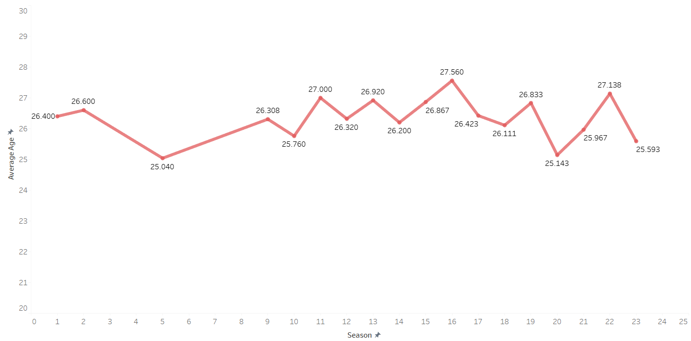
Season/Average Age Line Graph

Slide 10
Evaluation Question #2
Hypothesis: Hometown region is a predictor for success on the show. REQUIRES ADDITIONAL RESEARCH
While data implications made these results difficult to decipher, other figures allow us to draw tentative conclusions about the origins of many of the show’s Final 2 contestants. It appears that many of the Winners/Runner-Ups hail from either the Western or Southeastern regions of the United States
Another interesting thing to note is that NONE of the show’s Winners/Runner-Ups are from outside of the United States.
Results

Slide 11
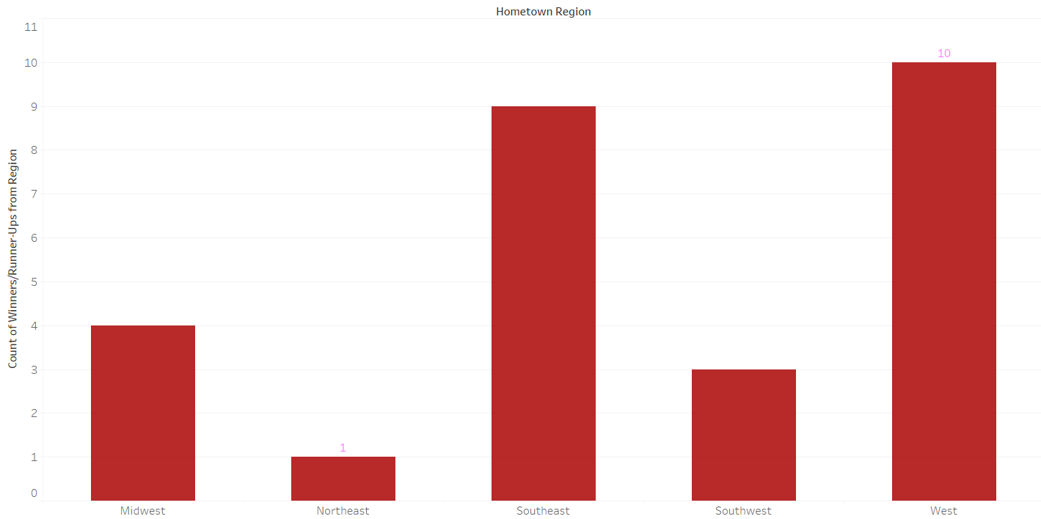
Hometown Region Count (Winners/Runner-Ups)

Slide 12
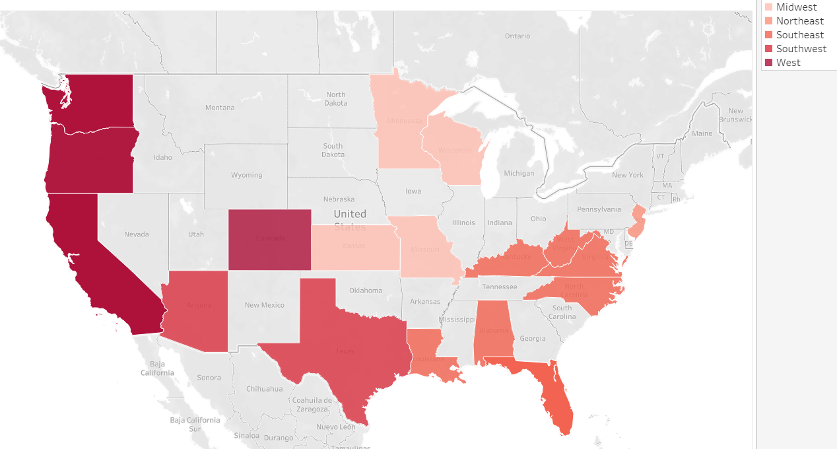
Hometown Region Map (Winners/Runner-Ups)

Slide 13
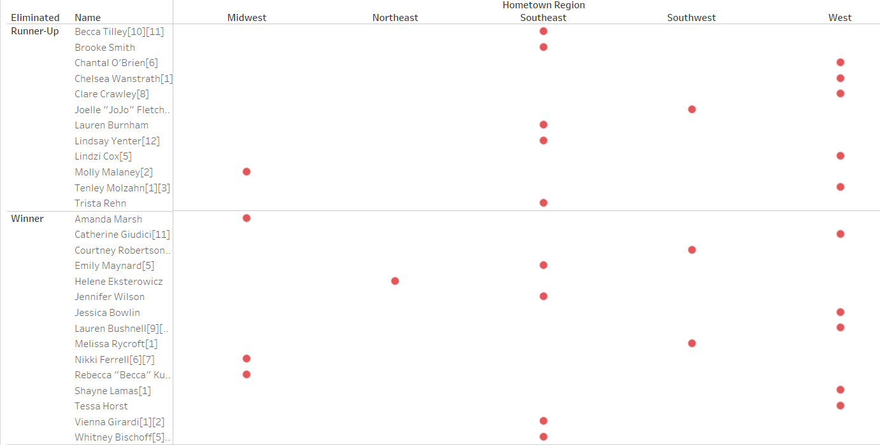
Hometown Region Chart (Winners/Runner-Ups by Name)

Slide 14
The average age of a Bachelor contestant has not varied much since the show’s inception (typically between 25- and 27-years-old).
The average age of a given season has never exceeded 28-years-old (given this data).
While most of the Final 2 contestants on each season have come from the Western & Southeastern U.S., it is difficult to say whether hometown region is a predictor for success on the show. It requires additional research.
Summary

Slide 15
Despite fluctuations in viewership, The Bachelor’s on-air longevity has been immensely influential to reality television programming while still reaching a wide audience.
However, the show’s appeal is limited to certain populations, religions, and races.
Average contestant age and hometown are only two of the variables that factor into the show’s continued success and impact.
Though some may consider the show frivolous and vapid, it offers an opportunity to examine and address larger issues in our society today.
Conclusions

Slide 16
Ideally, if I had more time and resources, I would love to…
…analyze Bachelor contestants’ social media reach and influence post-show, specifically how ABC could use those contestants’ appeal to monetize the brand further and draw in different audiences and potential contestants.
…analyze Bachelor couple success rates and variables that could be improved to increase longevity of the couples after the show is over. Increased couple longevity could help improve ratings.
If only…

Slide 17
Questions

Slide 18

Will you accept this Data Science Project?

